Slide 1
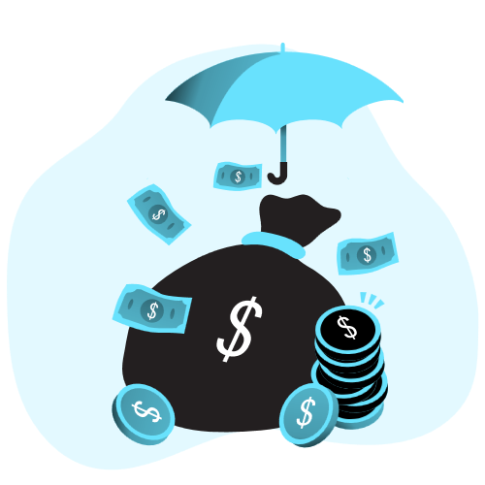
RANSOMWARE
ABDURRAHMAN QURESHI
242466

Slide 2

What is Ransomware?
Malware that encrypts files and demands payment for release
Comes from words "ransom" and "software" combined
It holds your data hostage, not just steals it
Payment demanded in cryptocurrency, which is hard to trace
Targets individuals, hospitals, banks, schools, and governments
Like someone changing all your locks and selling keys

Slide 3
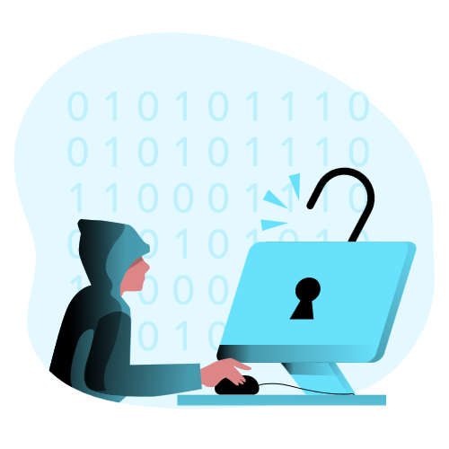
How It WORKS
Delivery : phishing email, malicious link, fake download, USB drive
Infection : malicious code runs, may stay silent for days
Encryption : files locked using AES and RSA encryption
Ransom Note : payment instructions, deadline, and amount displayed
Extortion : data often stolen first, then payment demanded

Slide 4
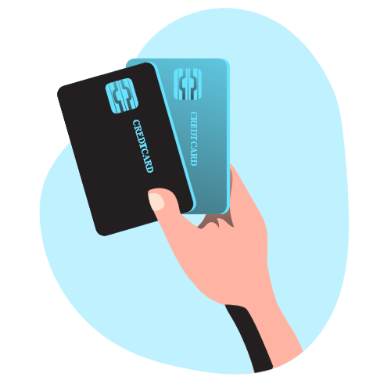
Types of RANSOMWARE
Crypto Ransomware : encrypts files, most common type today
Locker Ransomware : locks you out of entire device
Scareware : fake warnings, usually no real encryption
Leakware : steals data, encrypts it, threatens to publish

Slide 5
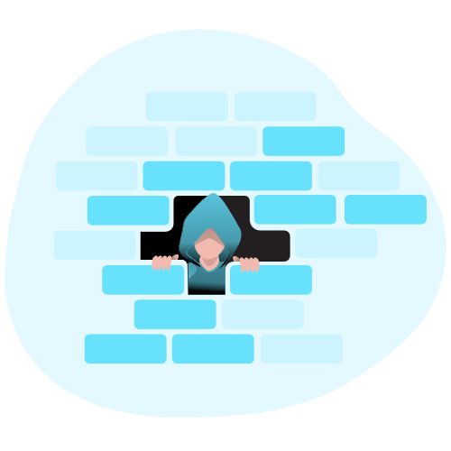
Motives to ATTACK
Money : primary driver, millions paid in cryptocurrency
RaaS : kits sold to criminals, profits shared between them
High-value targets : hospitals, banks, schools, governments targeted
Geopolitics : some groups protected or tolerated by states
Low risk, high reward : anonymous payments, cross-border attacks

Slide 6
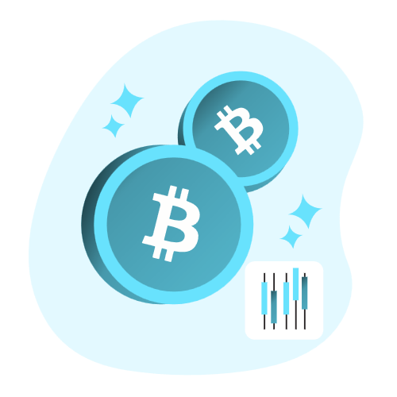
FAMOUS Attack INSTANCES
WannaCry (2017)
  - Hit 200,000+ computers across 150 countries worldwide
  - Crippled UK's NHS hospitals, surgeries and appointments cancelled
NotPetya (2017)
  - Disguised as ransomware and caused approximately $10 billion in global damage
Colonial Pipeline (2021)
- US fuel pipeline shut down for several days
- ~$4.4M ransom paid, gas shortages across East Coast
AIIMS Delhi (2022)
- Hospital services disrupted for days across India

Slide 7
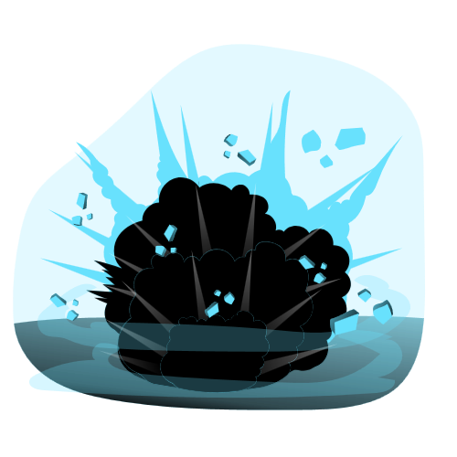
IMPACT
Data loss : files permanently gone without proper backups
Downtime : business operations completely halted for days
Financial loss : ransom plus recovery and legal costs
Reputation damage : lost customer trust and brand value
Real-world harm : delayed surgeries, fuel shortages, closed businesses

Slide 8
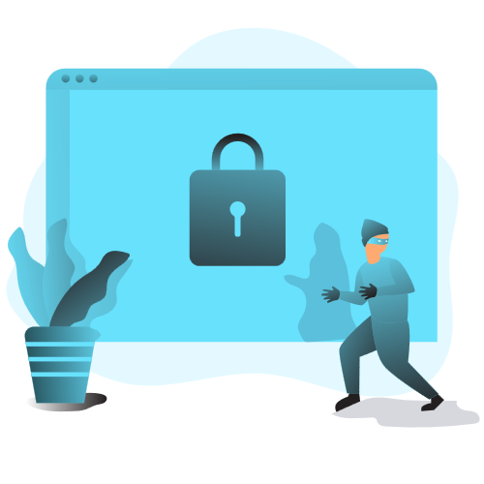
PREVENTION & PROTECTION
Backups : offline, offsite, tested regularly, best defense
Never open unknown links or email attachments
Keep systems updated and patched against vulnerabilities
Use antivirus, tools, and firewalls
Use strong password
Never pay ransom : no guarantee, funds more crime

